Slide 1
SLAM Using Sonar and Underwater Camera
University of Delaware

Slide 2
Outline
System Setup
Measurement Process
G2o formulation and solver
Simulation

Slide 3
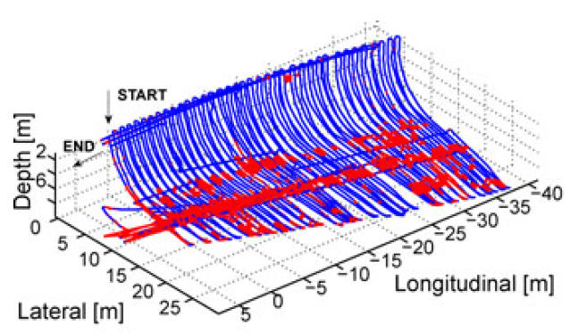
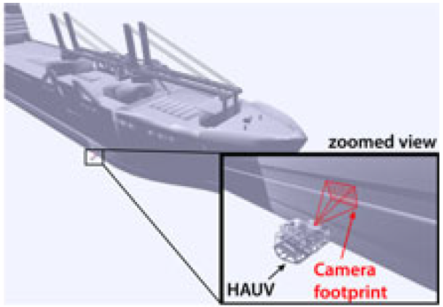
Background for Underwater 3D SLAM
Security inspection for dams, ship hulls, harbors and pipelines;
Growing scientific requirement of a regular monitoring of the underwater ecosystems. Tracking and modeling the changes in marine environment.
From Ayound Kim, 2013

Slide 4
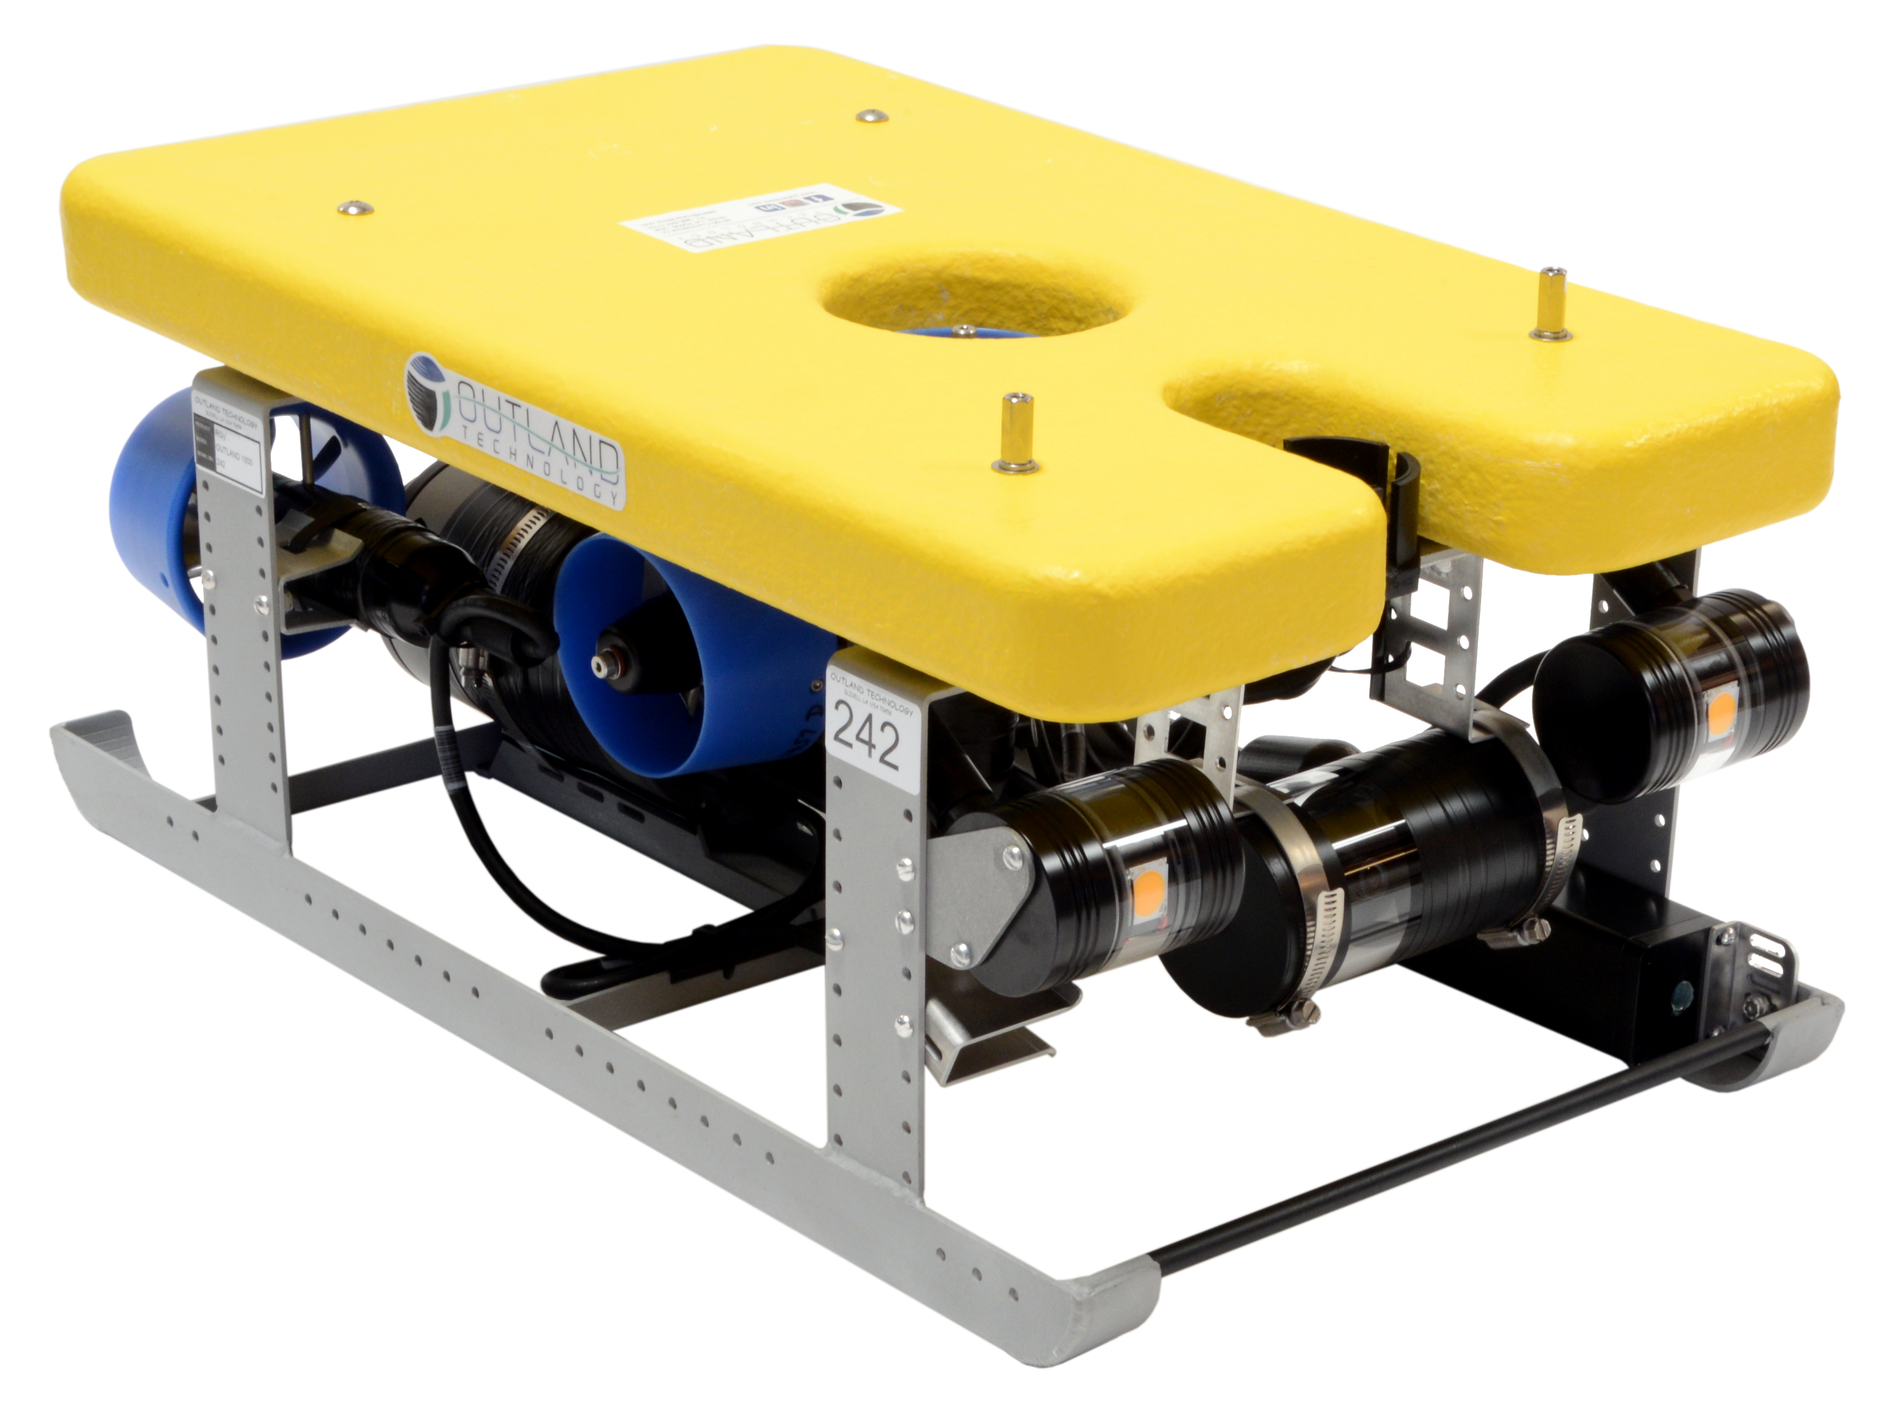
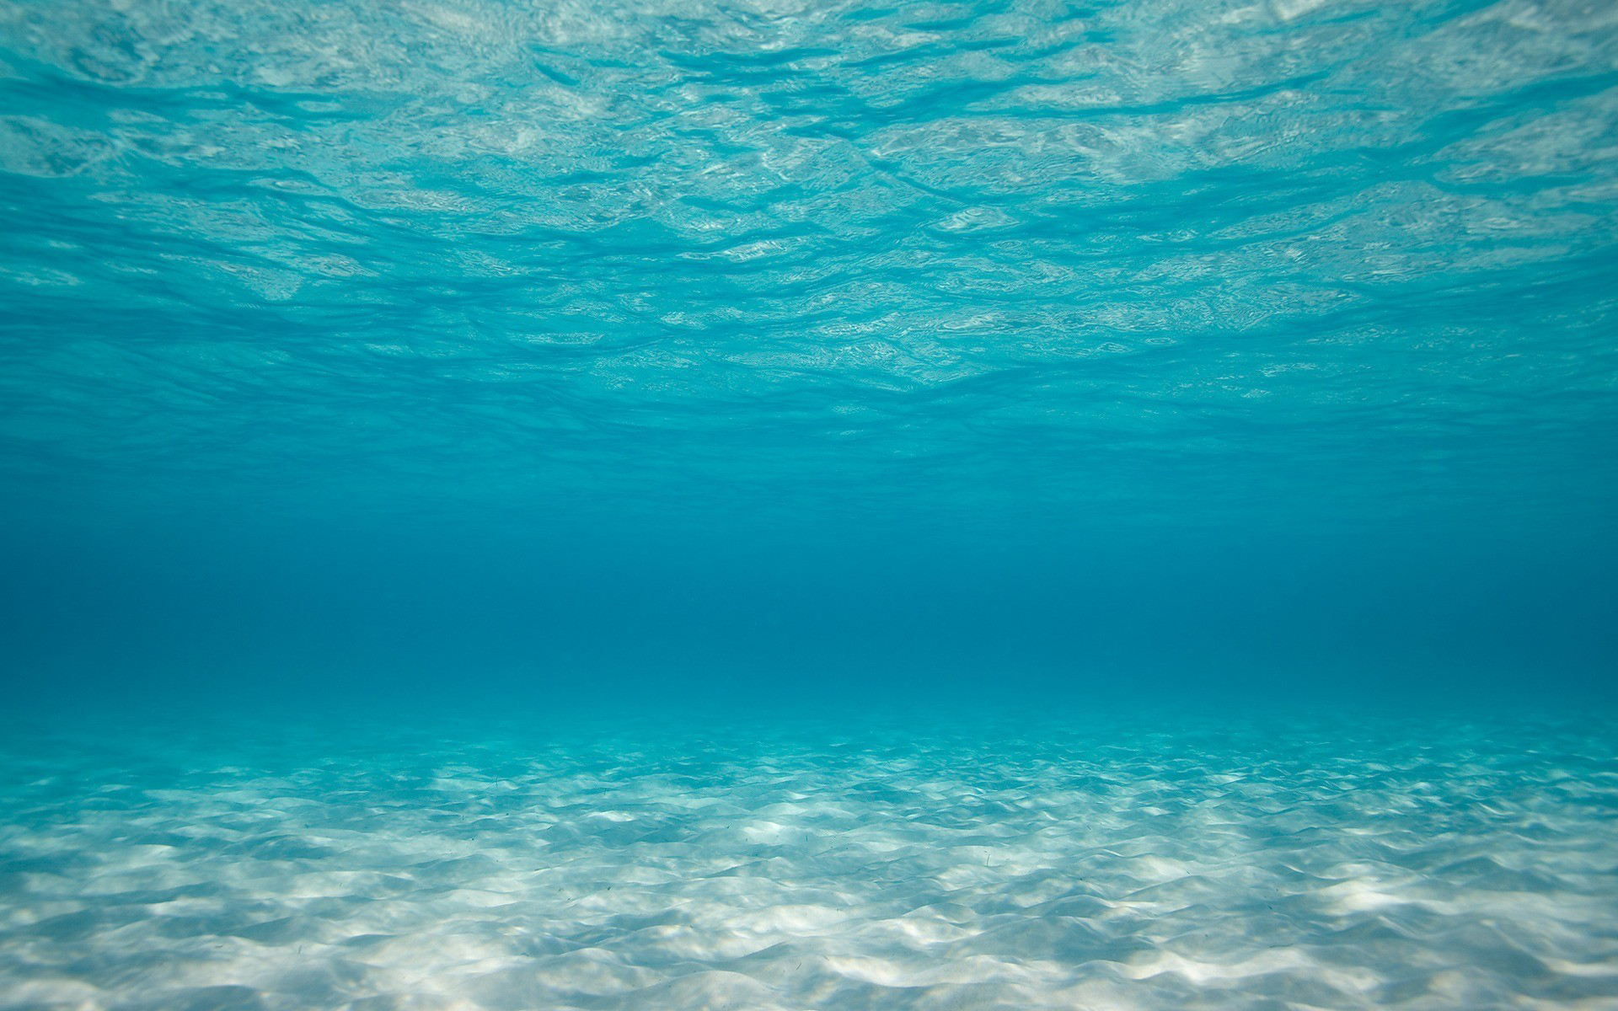
System Setup
Security inspection for dams, ship hulls, harbors and pipelines;
Recover 3D Feature points and sensor trajectory
ROV 1000 Outland, Underwater Camera, Sonar
Initialization with Sonar and Camera Measurement
G2O (general graph optimization) to get the final value
Sonar
Camera

Slide 5
Measuring Process

Slide 6
Solution Process
Data Generation:
Simulate the Camera and Sonar
dataset
Synchronization, Registration &
tracking are easier to realized with
simulated dataset
Solution:
Camera and Sonar meas pair for local 3D feature initialization
Use G2O solver for optimization to get the final value
G2O is a popular nonlinear least squares solver

Slide 7
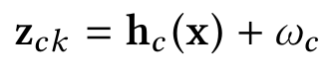
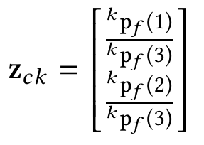
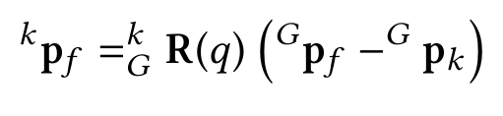
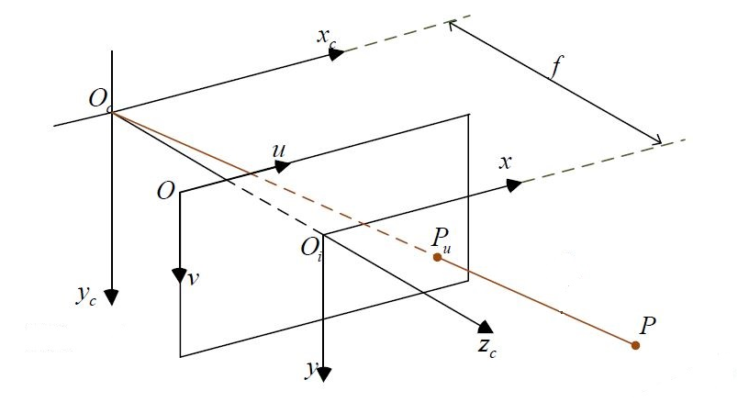
Measurement Model for Camera
Camera Measuring Model: Camera k measuring a feature f:

Slide 8
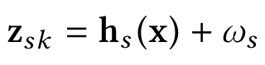
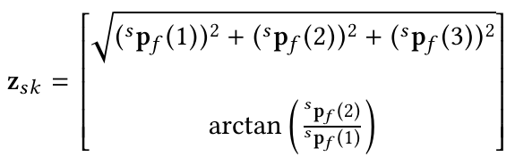
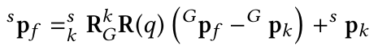
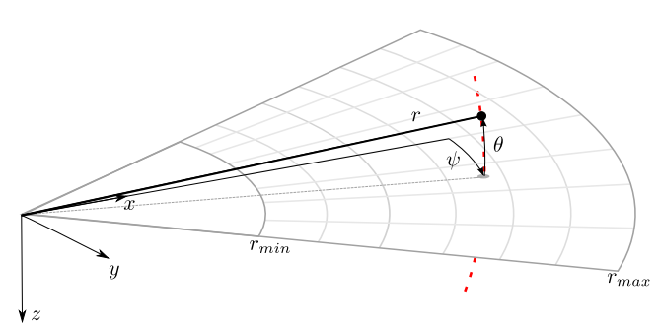
Measurement Model for Sonar
Sonar Measuring Model: Sonar k measuring a feature f:

Slide 9
Graph Representation

Slide 10
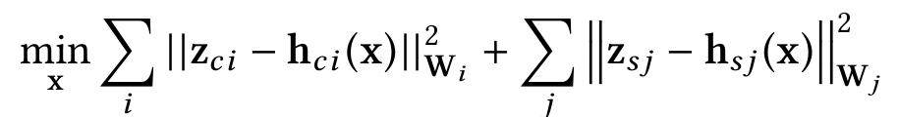
Math formulation
Target: get the best state vector x, includes:
Xcalib
Xc
Xf
Camera Sonar Calib
Camera State(0 … k)
Feature Position(0 … m)
Method: Minimize the following least squares with batch up optimization
Cam Meas residue
Sonar Meas residue

Slide 11
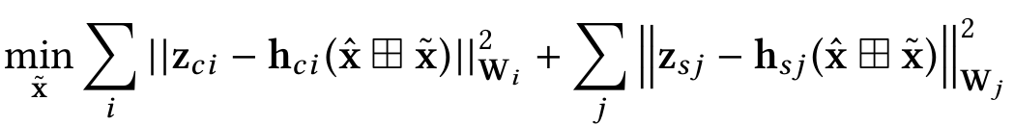

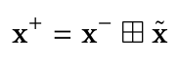
G2O Optimization Process
Use g2o for solving the nonlinear least squares
Initial guess for the vertices and edges
Using the newton type optimization method
First order Taylor expansion for linearization
Try to find the optimal best fit the problem
Get the optimal estimate by :

Slide 12
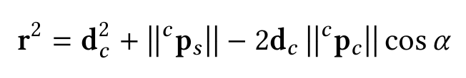
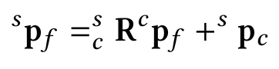
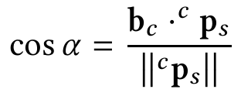
Camera Sonar Feature Points Initialization
Frame representation:
Triangular Method:

Slide 13
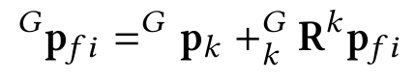
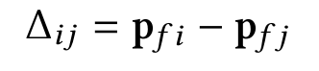
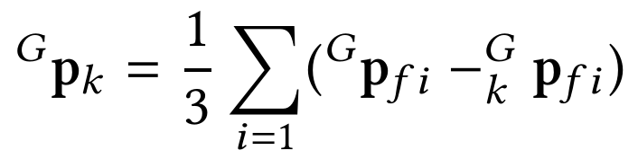
Init for CamTrajectory with 3 points
Frame representation:
3 corresponding points are needed for the trajectory recovery

Slide 14
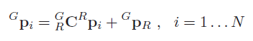
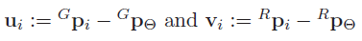
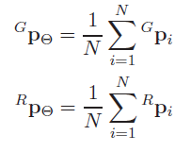
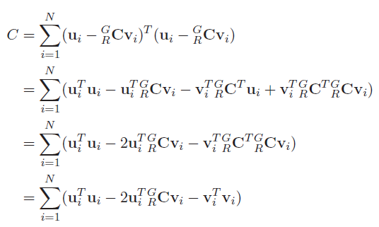
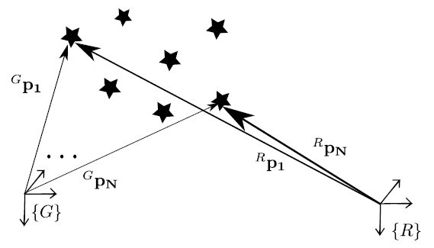
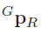
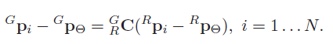
What if more points are available?
If more than corresponding points are available…
Define the differences:
Define centroids of points:
Formulate a least squares:
Separate and formulate:

Slide 15
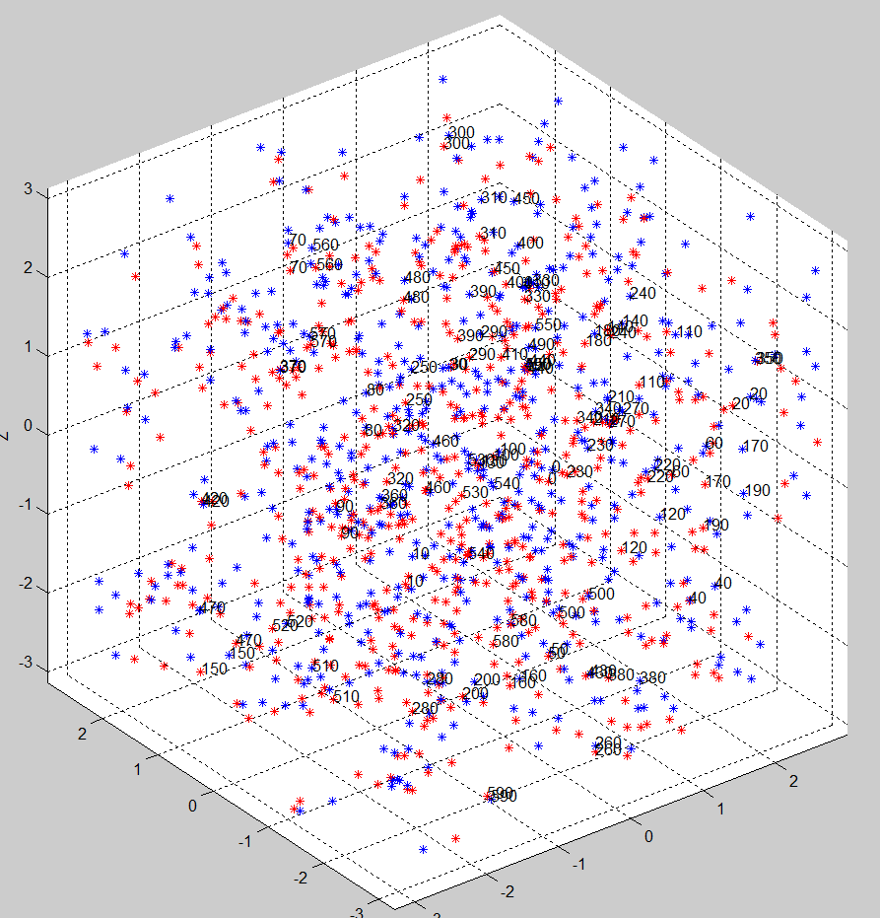
Simulation
Simulate the 600 feature points (point cloud)
20 robot poses
Add noises:
for camera: [-5,5] pixels to camera measurement
for sonar:[-5,5]degrees to ϴ and [-5,5]cm to radius
Raw value with initialization:

Slide 16
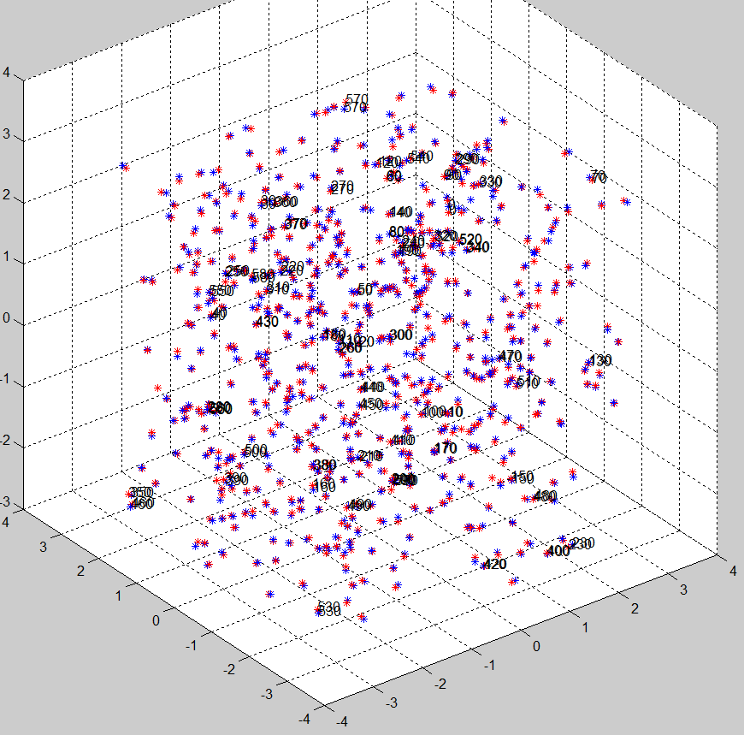
Initialization VS g2o Optimization

Slide 17
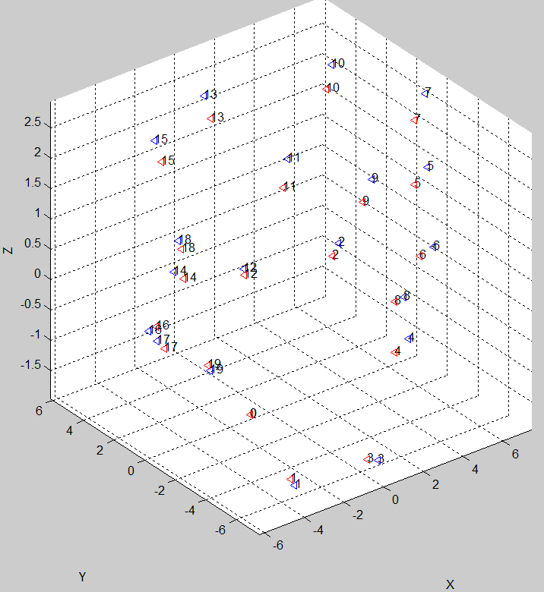
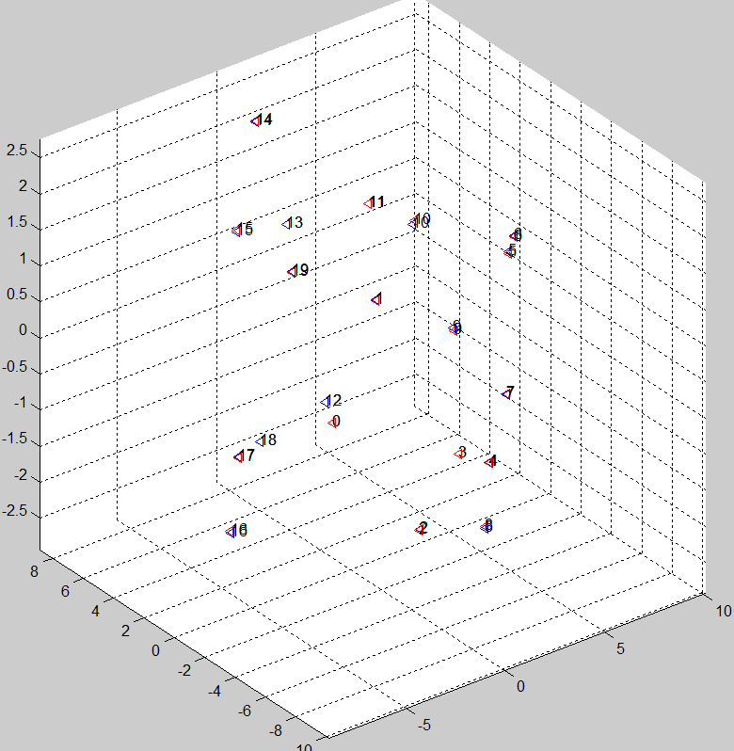
Simulation
Camera Pose Initialization
Camera Pose g2o Optimization

Slide 18
Thanks a lot!
Q&A

